Slide 1
Welcome to all
for the MHRM Online lecture
By
Dr. Dhiraj Ovhal
HOD of Commerce

Slide 2
Chapter -2
Marketing Decision –I
(Product and Price)

Slide 3
Q.3 Branding Concept and Components ?
Meaning:-
Brand means name. term, sign and symbol, colour, shape, size, etc are given to the products and which is registered under the trade and merchandise act for the legal protection i.e. no one copy the products.

Slide 4
Components of branding
1. Branding Personality
2. Brand function:
3. Brand Benefits
4. Brand Association
5. Brand Image:
6. Brand Name
7. Brand Logo
8. Brand Features and Design
9. Brand Packaging
10. Brand Equity:

Slide 5
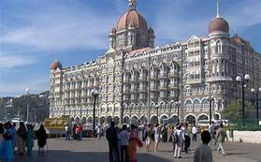
Branding Personality :-
Every brand has personality
Marketer should try to expose personality in front of customers.
Taj mahal hotel- business people - High status

Slide 6
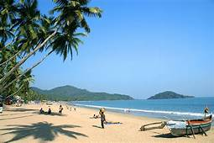
2.Brand function:-
Every brand performs certain function
Tourist hotels in Goa or Hill station perform certain function like recreation and relaxation, cleanliness, location, natural scenery, etc

Slide 7
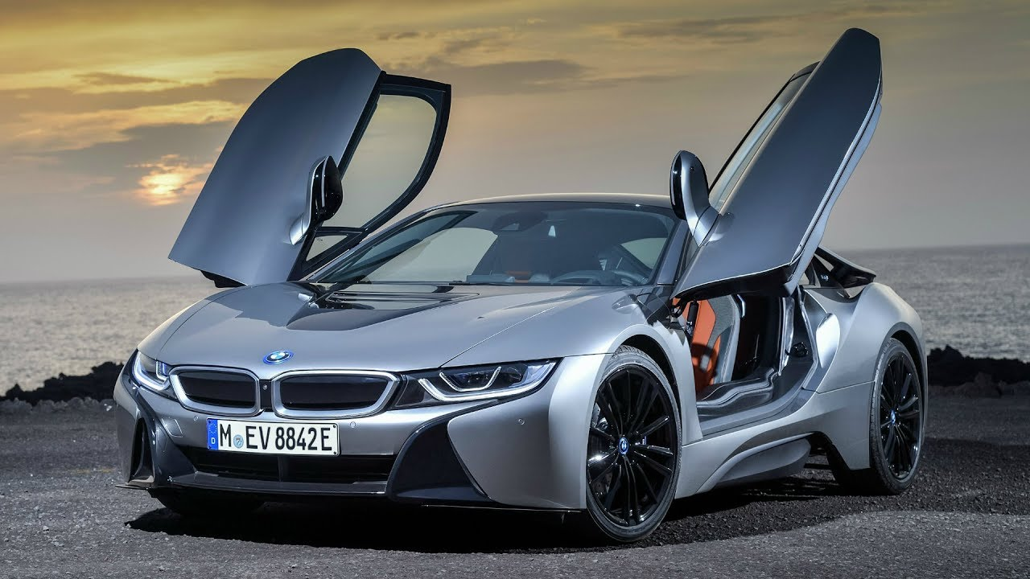
3. Brand Benefits:-
Tangible and Intangible benefits like BMW , Mercedes Car
Psychological benefits to the customers
Tangible:- Looks and design
Psychological:- Status , Ownership,

Slide 8
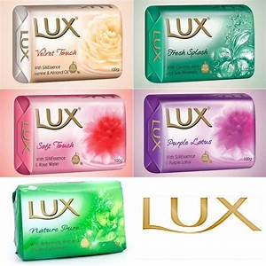
4. Brand Association:-
A brand must link or connect to certain association
Lux soap- Association of bollywood actress
Goa- Association of beautiful beaches
kerala- Backwater experience and Ayurvedic massage

Slide 9
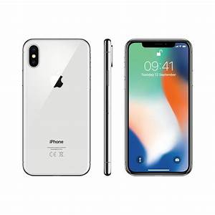
5. Brand Image:-
Brand image or reputation in the mind of customers
I-phone Luxury mobile and High quality

Slide 10
6. Brand Name :-
In the mind of customers
Corporate name:- Tata Salt, Tata Nano, Tata Hexa,
Corporate cum Individual brand name :- Cadbury dairy milk
Umbrella name:- Amul Butter, Amul milk, Amul chocolate
Founder name:- Colgate,Nestle, Ford

Slide 11
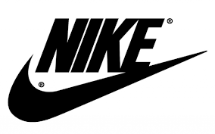
7. Brand Logo :- along with brand name it facilitate to customers
Nike √,

Slide 12
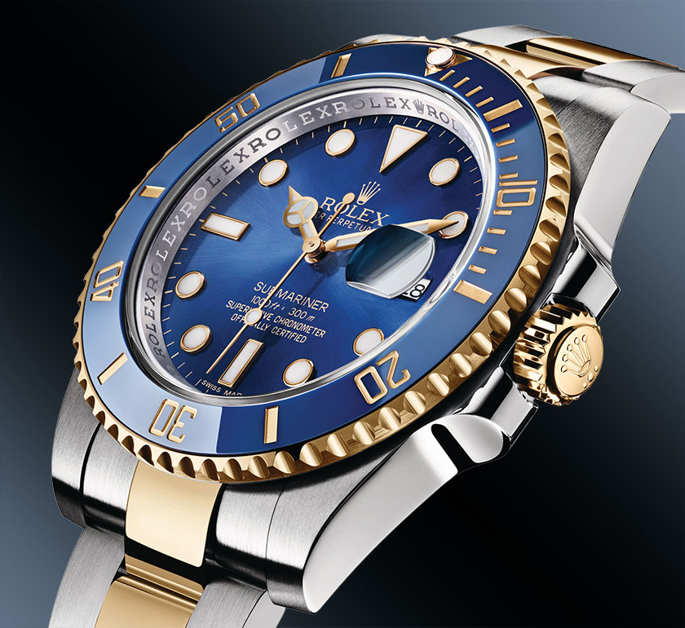
8. Brand Features and Design:-
It represents essential component of Brand
Rolex watches- highly costly with special design

Slide 13
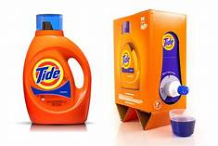
9. Brand Packaging:-
Environmentally friendly and Recycle

Slide 14
10. Brand Equity:-
It means incremental value of brands which it commend in market
It means fix image in the mind of customers
To create addition values and images in the mind of customers
( Nirma Washing powder and Nirma Biscuits
Dettol soft drink...)

Slide 15
Components of branding
1. Branding Personality
2. Brand function:
3. Brand Benefits
4. Brand Association
5. Brand Image:
6. Brand Name
7. Brand Logo
8. Brand Features and Design
9. Brand Packaging
10. Brand Equity:

Slide 16
Thank You

Slide 17
Attendance Link
https://forms.gle/Xqvykv5vfEi1zpyF7
(Mention date at last point)

